Slide 1
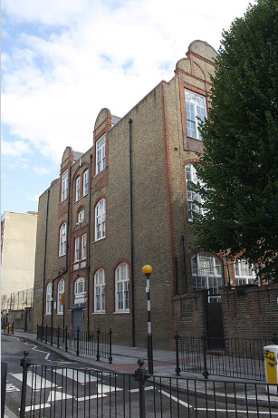

St Peter & St Paul Catholic Primary School
February 2026
Borras Construction are delighted to announce that we have been awarded the refurbishment contract at St Peter & St Paul Catholic Primary School. As part of our ongoing commitment to safety and excellence, we look forward to delivering these essential facility upgrades.
The Works
Repair and replacement of windows
Repairs to external façade and the rain water pipework & guttering
General maintenance and internal repair works
Works are scheduled to commence late March 2026 with completion planned for late August 2026.
Introduction to Borras:
Headquartered in St Albans, Hertfordshire, Borras operates successfully in all areas within a 70-mile radius.
Founded in the early 1980’s by Rae Borras, we have grown into a successful business, generating a turnover circa £50 million per annum.
Spanning London and the Home Counties, we operate in all sectors of the construction industry from housing and education through to health, commercial work and specialised works.
Working Hours:
Monday - Thursday 08:00-17:00
Friday
08:00-16:00
Please note:
Any weekend works will be prior arranged with the project administrator.
www.borrasconstruction.co.uk

Slide 2

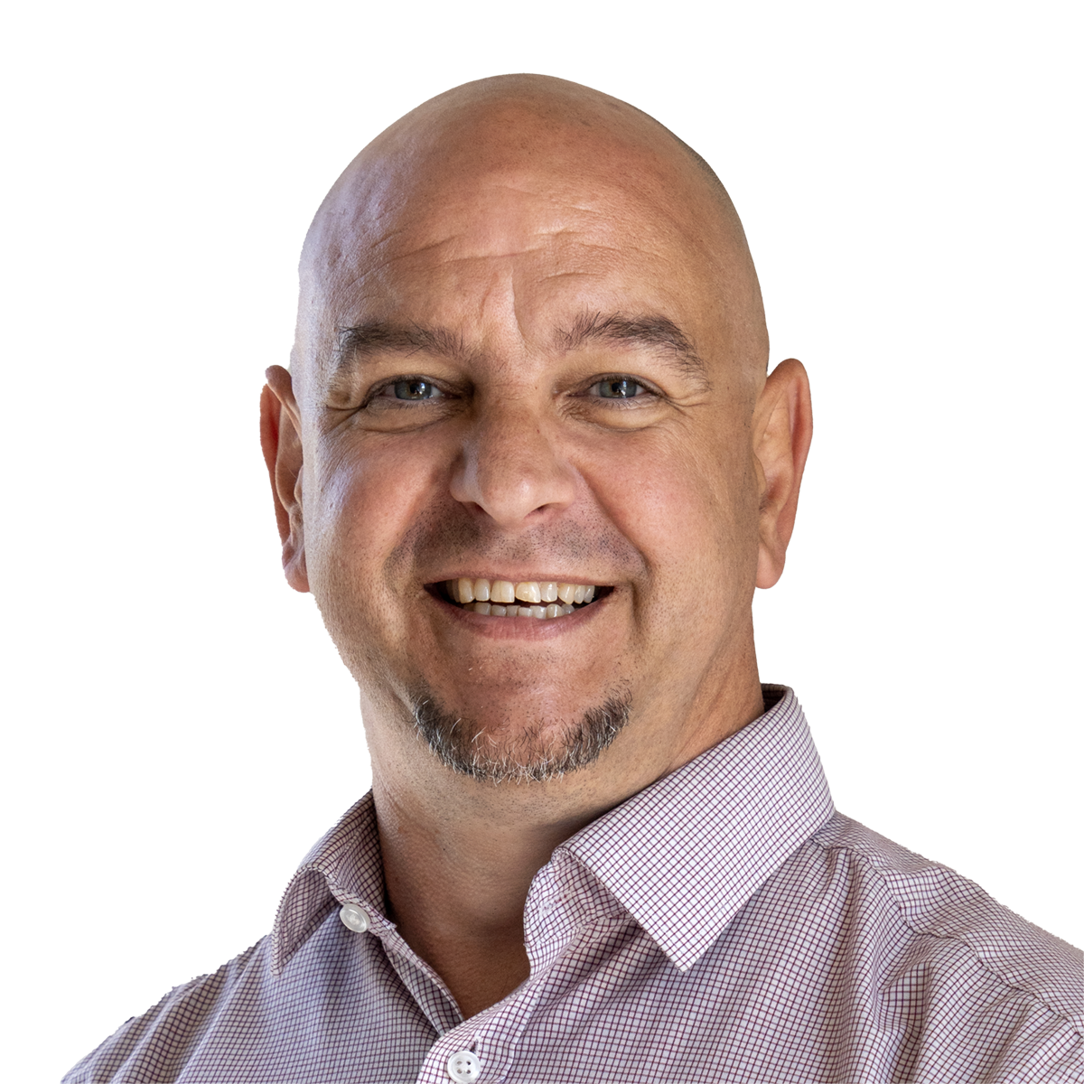
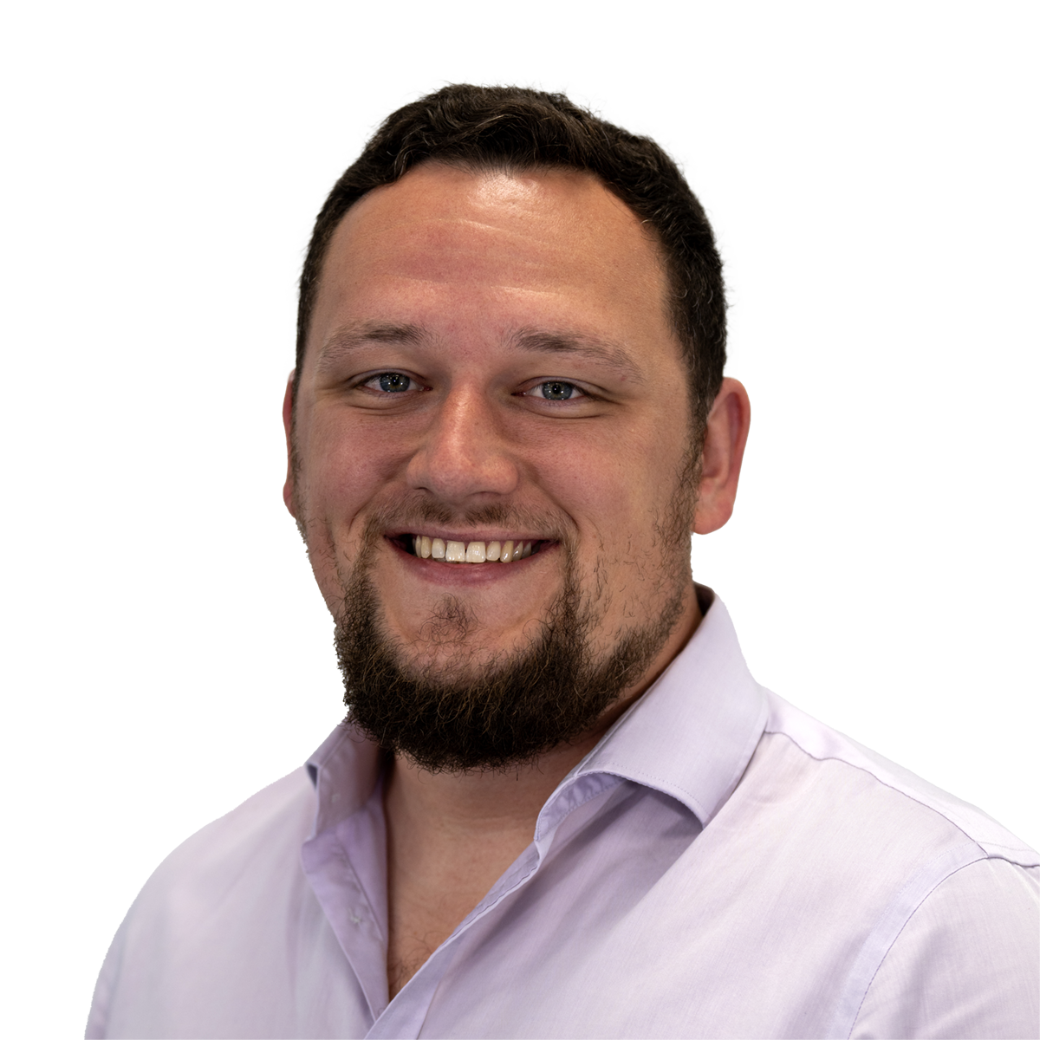




Meet the team:
Site Manager
jcurley@borrasconstruction.co.uk
Phone no 07837 824142
Our Site Manager, will be permanently site based, responsible for the planning, co-ordination, health and safety and work management. The main contact for local residents, should you have any queries or issues in relation to the project, please do not hesitate to contact him and he will do his very best to answer them.
Contracts Manager
dswainston@borrasconstruction.co.uk
Our Contracts Manager, will be responsible for the overall management of the project, visiting site regularly and dealing with every aspect of the project including relationship management of clients, consultants and of course local residents.
Senior Surveyor
gperceval@borrasconstruction.co.uk
Our Surveyor role encompasses all surveying duties from pre-contract through to settlement of the Final Accounts to include liaison with the management and site teams to ensure the full successful delivery of the project.
James Curley
Site Manager
Darren Swainston
Contracts Manager
George Perceval
Senior Surveyor
Environmental Issues:
We have prepared a Construction Environmental Management Plan in line with Southwark Councils requirements.
This is a live document which will be reviewed and updated at least once a month.
This then motivates our site management team to implement processes which will help to minimise the effects of our activities on the environment.
In addition to the aforementioned, we also appoint a site based environmental and sustainability champion to implement and monitor the effectiveness of all environmental measures taken.
Considerate Constructors:
We have registered our site with the Considerate Constructors scheme and agree to abide by the Code of Considerate Practice, designed to encourage best practice beyond statutory requirements.
Respect the Community
Care for the Environment
Value their Workforce
Our site teams make every effort to improve their scores at each audit and our Site Manager will ensure that this project is no exception.

